Slide 1


Abalone Age Determination
A Data Science Approach

Slide 2
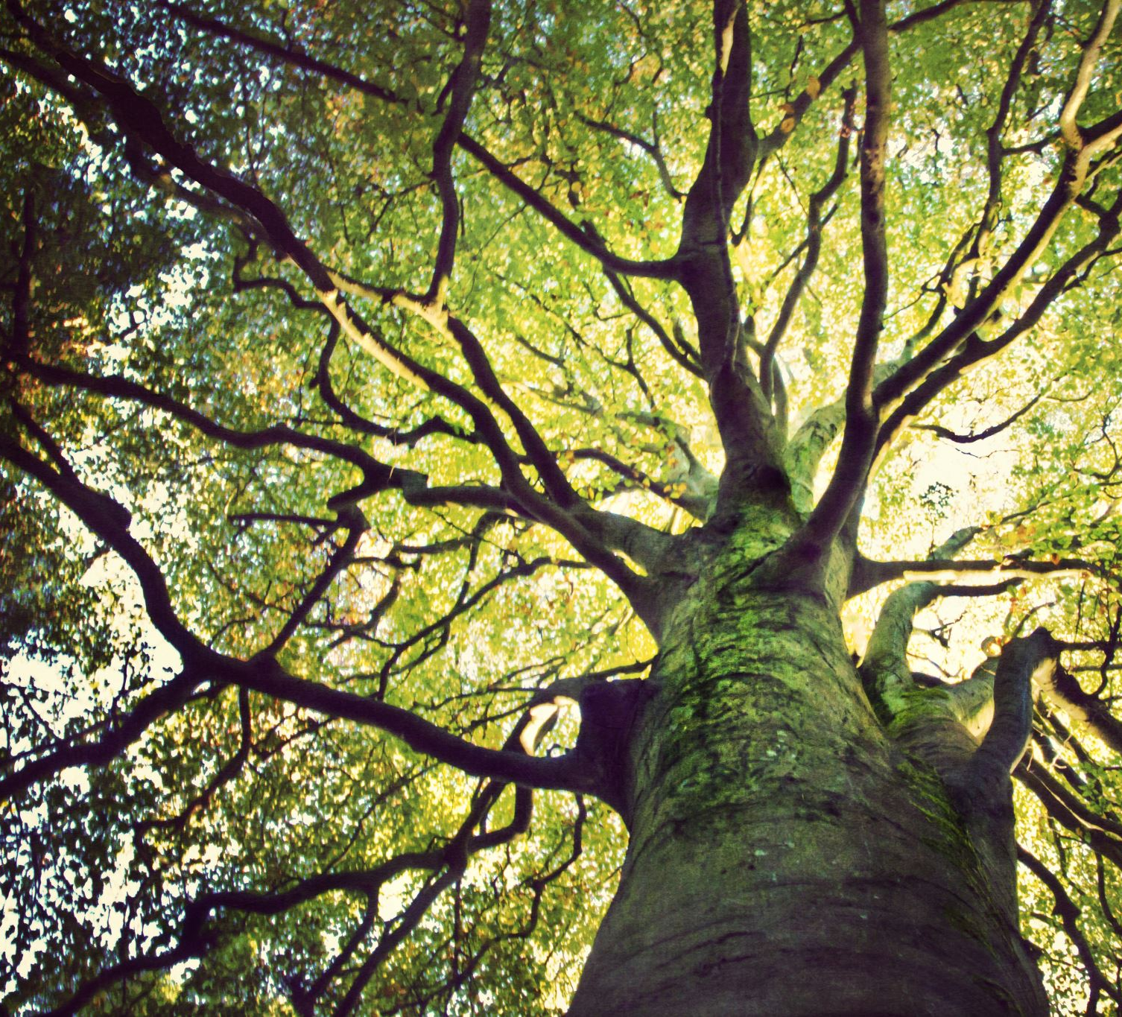
Random Forest Regression

Slide 3
Jason Smith
D214 Task 3 - Graduate Capstone Student ID: 293963 jsmi268@wgu.edu WGU – MSDA Program Mentor: Christiana Okhipo Instructor: Daniel Smith

Slide 4
My Introduction
Molecular biology background
10+ years with database technologies
Analytical thinker
Convey and Collaborate
Love to learn new stuff

Slide 5
Research Question
Can the age of an abalone be predicted based on an abalone’s 'sex', 'diameter', and 'whole weight'?

Slide 6
'Sex', 'Diameter' and 'Whole weight' statistically significantly affects the dependent variable 'Age'.
.
Hypothesis

Slide 7
REVISION
The sex of the abalone was removed
Numeric features only

Slide 8
Goal & Theory
As an abalone gets older, it grows additional growth rings
More growth rings = increased weight and diameter
Random Forest Regression

Slide 9

Why do we really care?
Age by counting growth rings
Requires shucking and cutting the shell
The animal must be killed

Slide 10

Data Source
Abalone Dataset
from Kaggle(Mendes, 2018)

Slide 11

Data Collection

Slide 12
No location No weather No food resources No predation
Data disadvantages

Slide 13
It’s free! Good quality
Data advantages

Slide 14
Data Extraction and Prep.

Slide 15
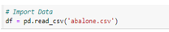
Import the data

Slide 16
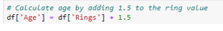
Calculate True Age from Rings

Slide 17

Cleanining

Slide 18
Clean the Data
Remove
NULL values
Duplicates
Non-english
Stop words
Caps

Slide 19

Why clean?
The data needs to be interpretable by the algorithm.

Slide 20
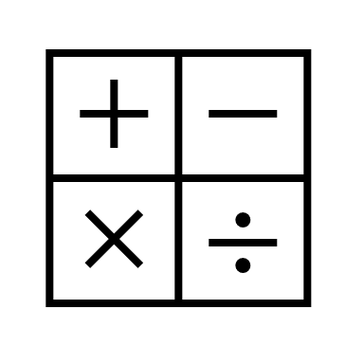
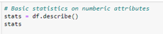
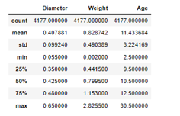
Basic Statistics

Slide 21
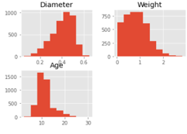
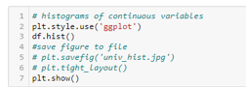
Distribution

Slide 22
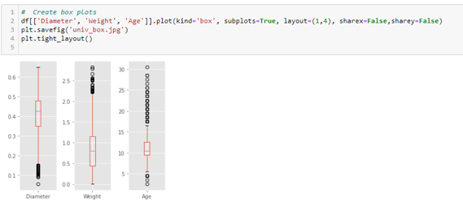
Check for Outliers using Boxplots

Slide 23
Correlation
Highly correlated: values are close to 1.0 & color is brown or tan
Not highly correlated: values close to 0 & color is black

Slide 24
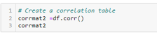
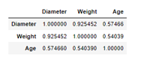
Correlation Table

Slide 25
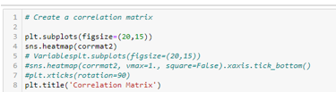
Correlation Matrix

Slide 26
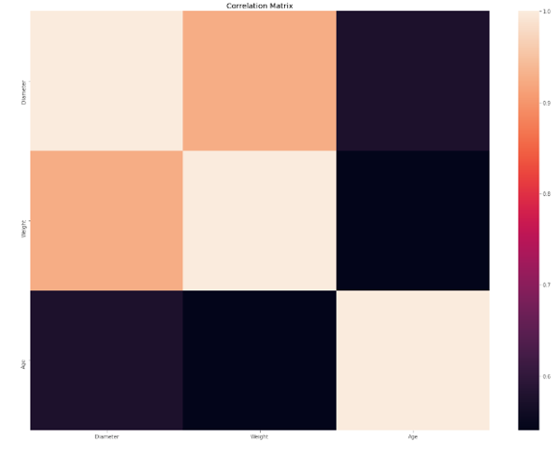

Slide 27
Correlated:
Diameter and Weight
Not correlated:
Age and Diameter
Age and Weight

Slide 28
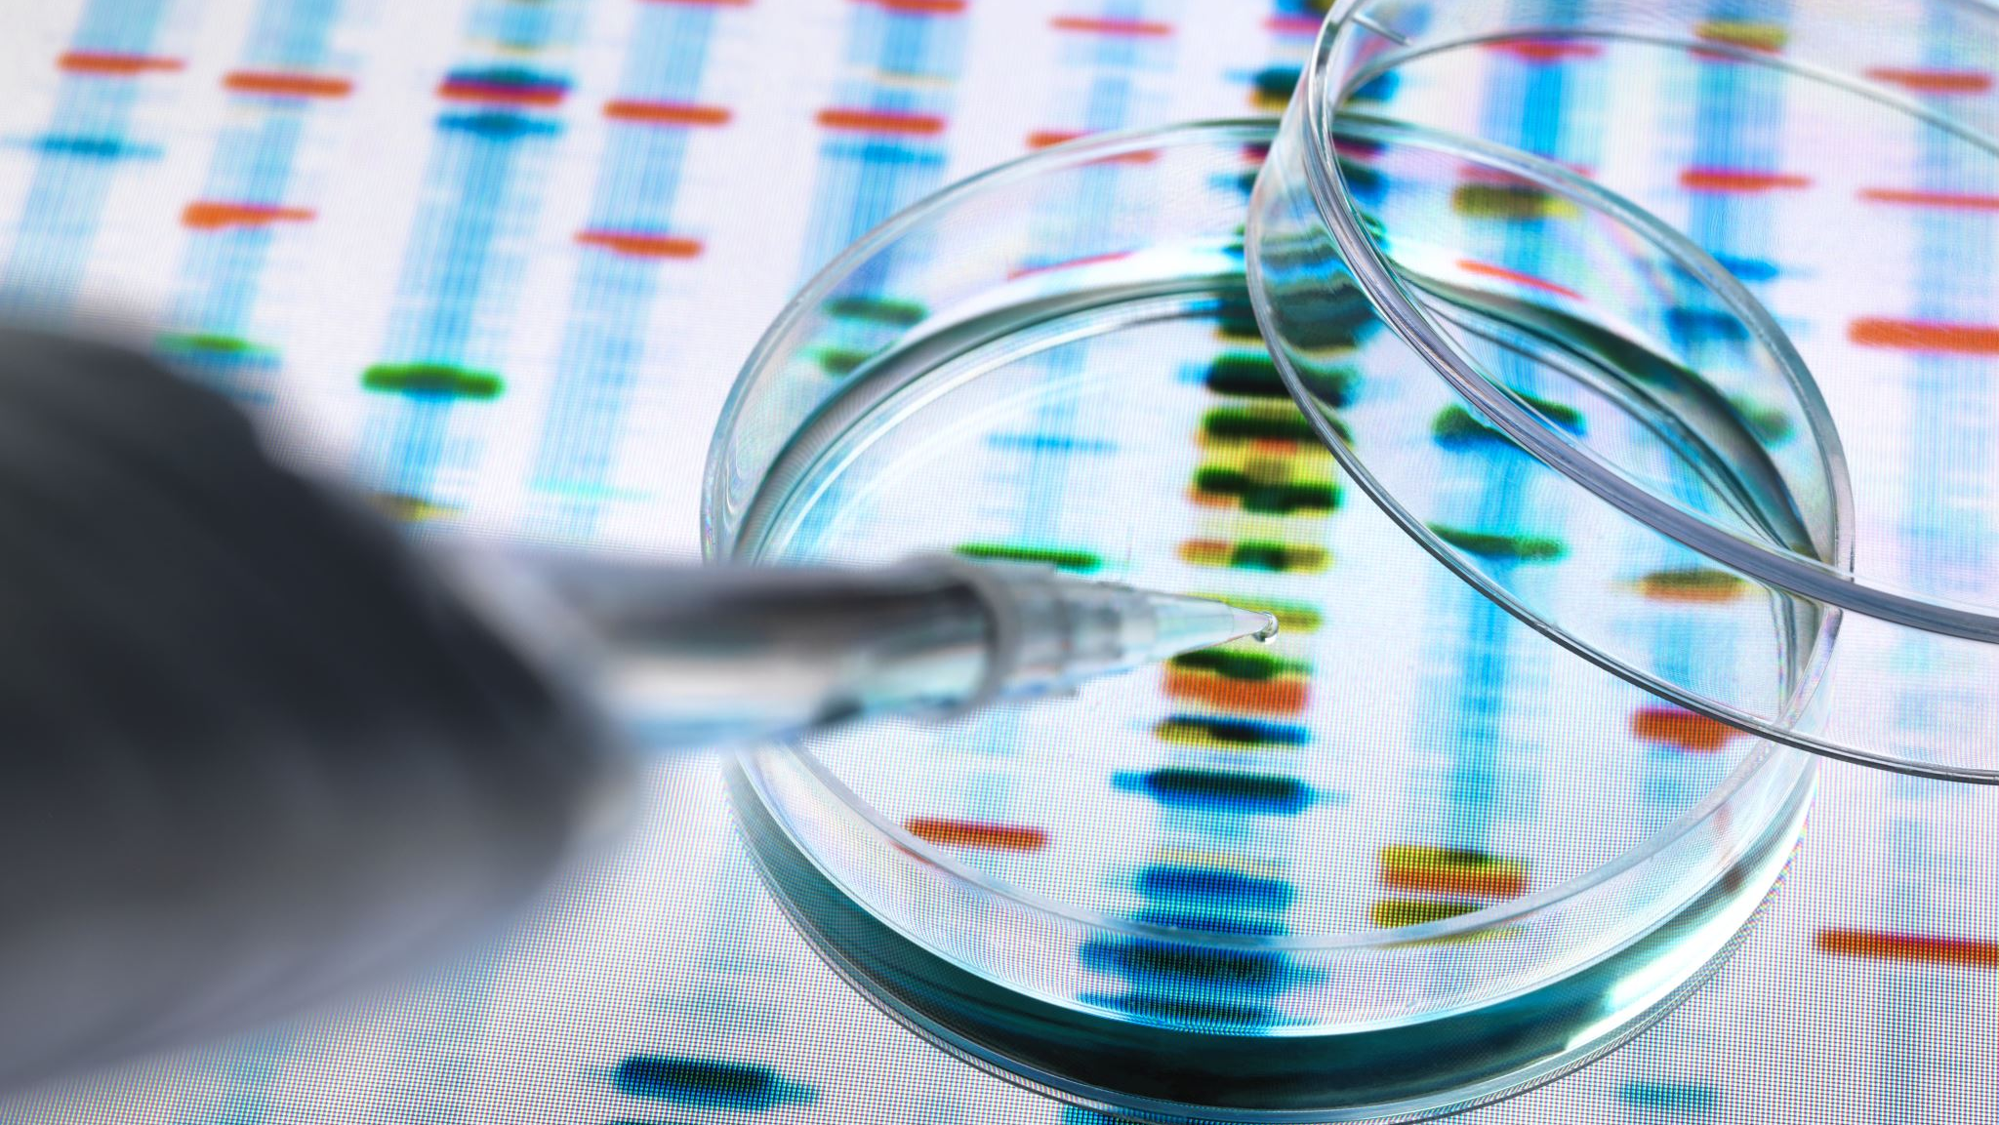
Prep for Analysis

Slide 29
70% train 30% test sklearn.model_selection train_test_sp
Split the Data

Slide 30
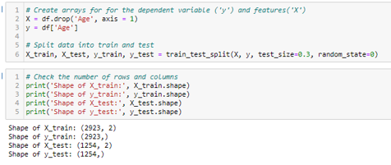
Train / test code

Slide 31
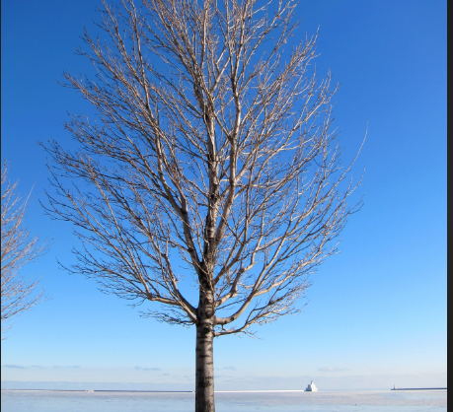
Analysis with Random Forest Regression

Slide 32
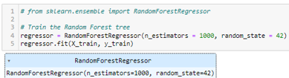
Create a Model for Predicting
1,000 decision trees.

Slide 33
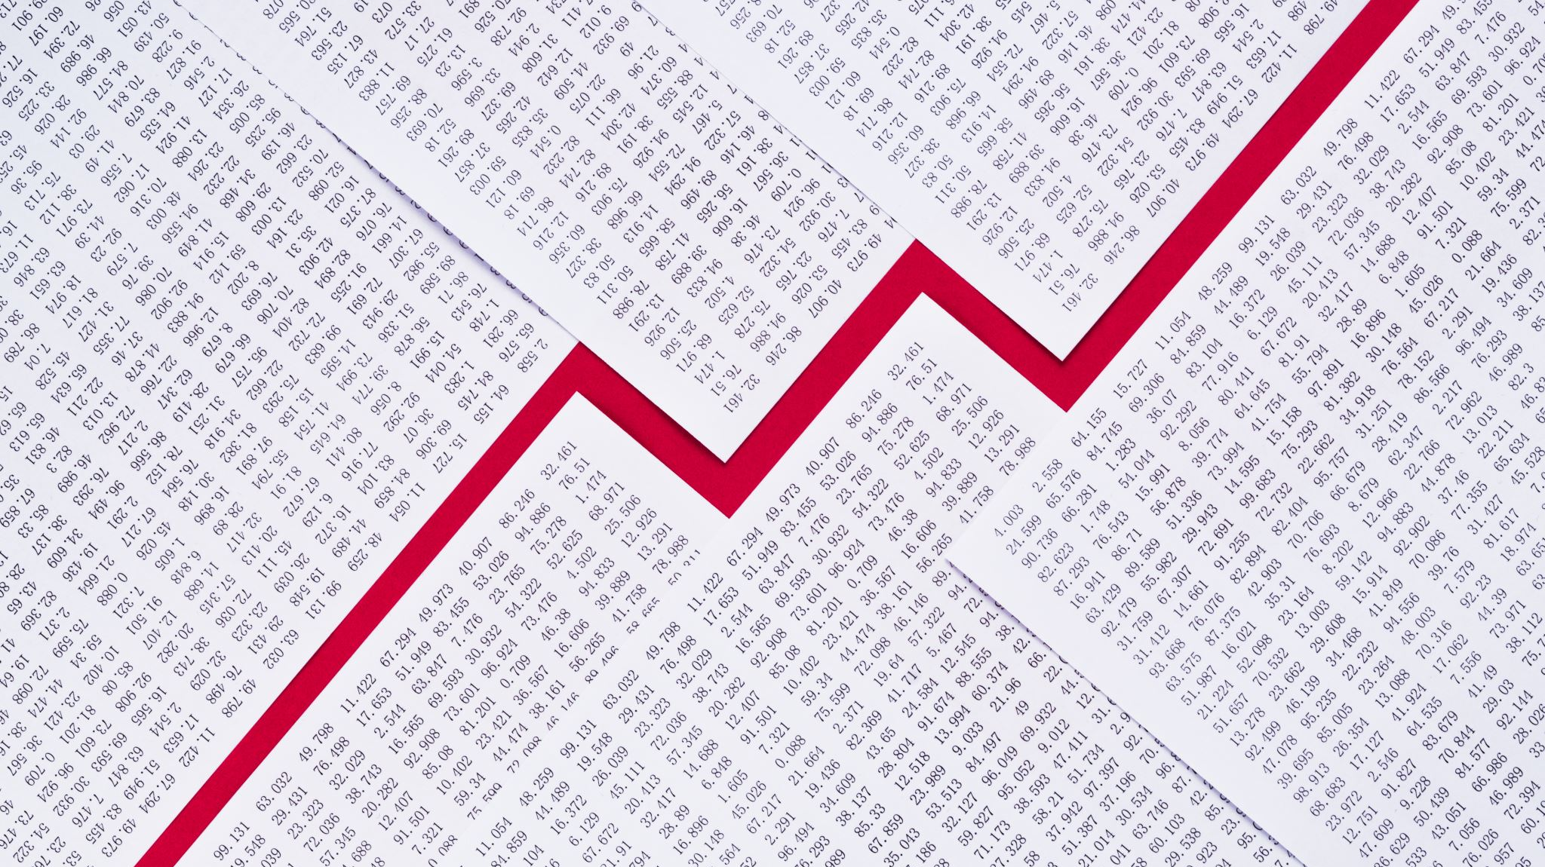
Results

Slide 34
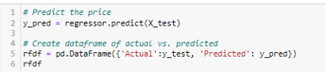
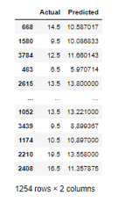
Actual vs. Predicted

Slide 35

Evaluate Prediction Model

Slide 36

Accuracy Calculation
Error Rate = |Observed Value - Actual Value|/Actual Value × 100
Accuracy = 100% - Error Rate

Slide 37
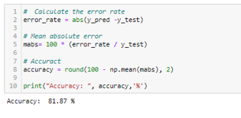
Accuracy

Slide 38

Well, did we achieve the goal?
82% Accuracy
Not statically significant

Slide 39
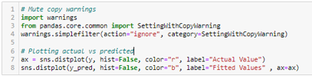
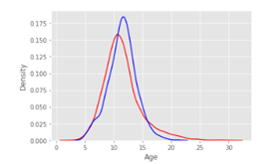
Plot the Results

Slide 40

Can we make it better?
Yes, here is how.

Slide 41
Filter on one gender and reapply model
Bring in other features from the original dataset
Hyper parameters tuning
N_estimators
Max_depth

Slide 42

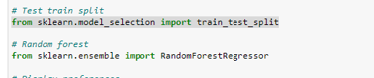
Tools
Python with Jupyter Notebook
SKlearn

